Slide 1
Rebuild 227 Cousins:
Historic Preservation Design Committee Review

Slide 2
Purpose and Concept
Purpose : To acquire City of Slidell Historic Preservation District Design Review Committee concurrence on plan to rebuild structure at 227Cousin Street.
Concept of Building: For the exterior to match in character and color pre-fire look

Slide 3

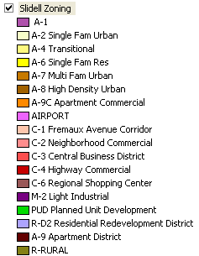
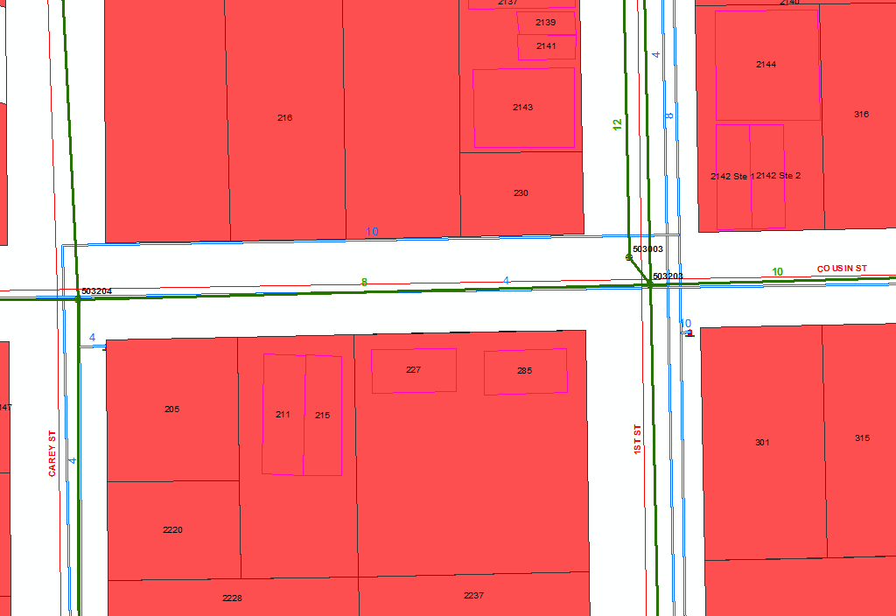
227 Cousin St, Slidell, LA Zoned As: C-3, Central Business District Prepared by: Eric Lundin, Planning Department on 16 August 2013
227 Cousin St
Cousin St
Details on zoning can be found at http://library.municode.com/index.aspx?clientId=11576 select Appendix A then Part 2 then the zoning class.
Carey St
2d St
DISCLAIMER:
This map data has been compiled from the most accurate data sources available to the City of Slidell. However, this produce is for reference purposes only and is not to be construed as a legal document or survey instrument. Any reliance on the information contained herein is at the user’s own risk. The City of Slidell assumes no responsibility for any use of the information contained herein or any loss resulting there from.
If you have any questions regarding the above or would like additional information, please contact the City of Slidell.
Council District: A/A

Slide 4
Details
Reutilize existing brick, if required new brick color will be “Old New Orleans hard tan.”
Canopy will be standing seam roof system and its color will be “New Orleans Green.”
The windows and doors will be standard commercial anodized aluminum framing with double insulated glass as shown on the plans.
Since the original windows were single pane wouldn't it be prudent to use commercial storefront single pane insulated which it what I had originally intended.
Could use bronze frame or green frames so windows will not appear so commercial looking.
So not recommend wrapping frames in wood because moisture could eventually get between the aluminum frame and the wood and create a problem
We will try to reuse the column supports that are currently still standing and paint those black.
The exterior lighting will be mounted underneath the canopy and not seen from the street. Planning on using a standard exterior 4' fluorescent fixture.

Slide 5
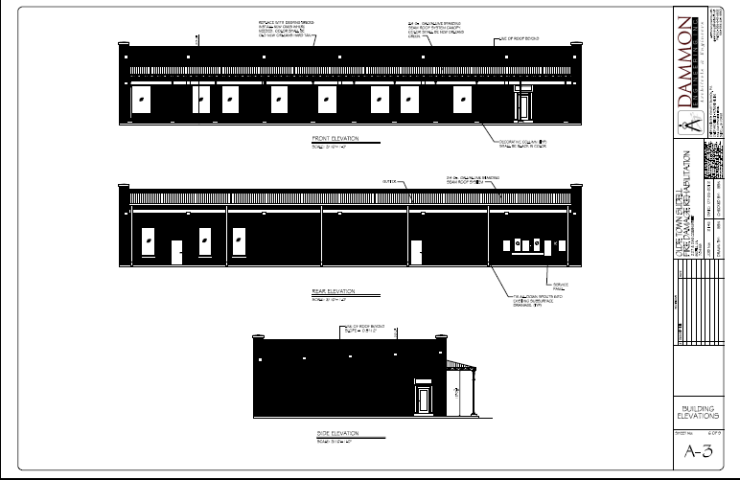
Elevations
See accompanying PDF for greater detail

Slide 6
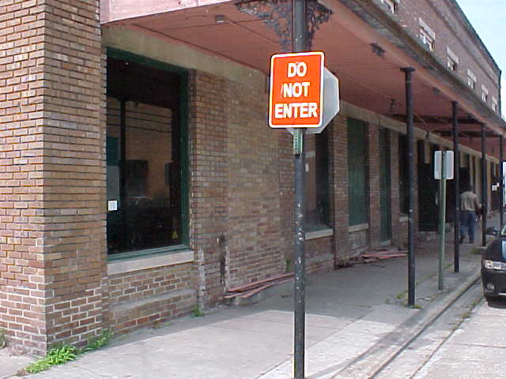
Match previous brick color and style

Slide 7
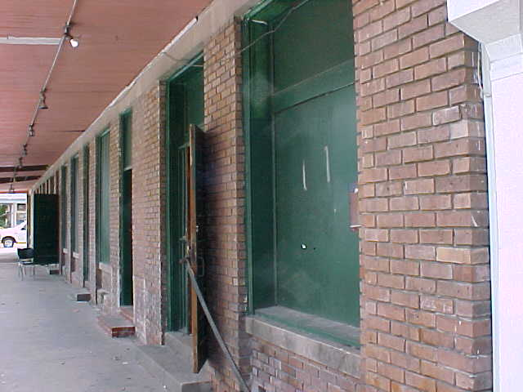
Match previous awning, doors, and windows

Slide 8
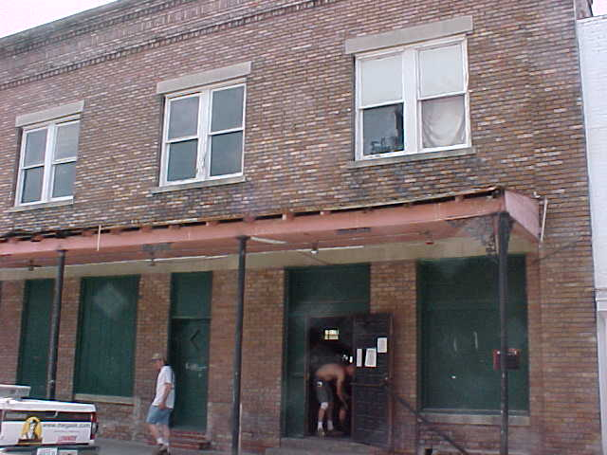
Match previous awning, doors, windows, and support poles

Slide 9
Request
Request member of Historic District Design Review Committee review plans and provide their concurrence or non-concurrence, with isuses, by Wednesday 11 September.
Provide responses to
Eric Lundin at
E-mail: elundin@cityofslidell.org
Phone: 646-4321

