Slide 1
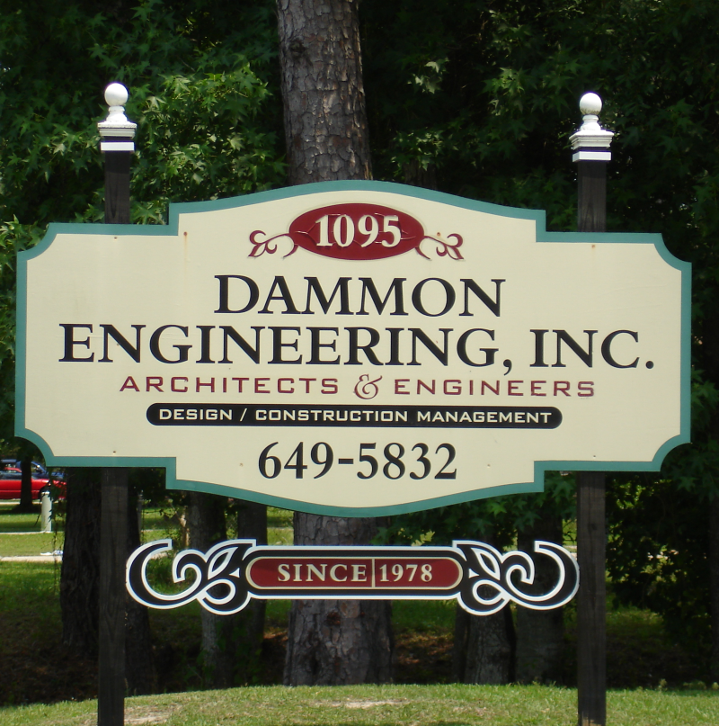
DAMMON ENGINEERING, INC.
Architects & Engineers
Full Service Design Team
All Disciplines “In House”
Architecture
Engineering
Civil
Structural
Mechanical
Electrical
Plumbing
Proudly Serving the Gulf South Region Since 1978
Notes:
First, we would like to thank you for taking the time to allow us to introduce ourselves and tell you a little bit about Dammon Engineering.
Dammon Engineering is a local company with our office right here in Slidell. In fact, you may have seen our sign on Florida Avenue right across the street from Slidell Memorial.
Dammon Engineering is an architectural and engineering firm with a full service design team. As such, we are able to provide all disciplines of Architecture and Engineering “in house,” including: civil, structural, mechanical, electrical & plumbing.
Our company was founded in 1978. We are licensed to perform work in Mississippi, Texas and Louisiana. Dammon Engineering has been proud to serve the entire gulf south region for over thirty years.

Slide 2
Generations of Experience
President & Chief Engineer, Emmett G. Dammon
Over 48 years of experience
Chief Architect, Robert L. Wiltse
Over 34 years of experience
Chuck Dammon
David Dammon
Kirt Dammon
OVER 100 YEARS OF COMBINED KNOWLEDGE & EXPERIENCE AT YOUR SERVICE
Notes:
After serving in the United States Army, Emmett Dammon graduated from Lamar University in Beaumont, TX. Following college, Mr. Dammon worked for Boeing and Martin Marietta where he started as a design engineer and later held a management position in civil, structural, electrical & mechanical engineering. He opened Dammon Engineering in 1978. Mr. Dammon is twice past president of the Rotary Club of Slidell, past Chamber of Commerce Vice President, a district officer of Rotary International, recipient of the Slidell Chamber of Commerce “Emmett G Dammon Ethics in Business Award,” past member of the St. Tammany Parish Board of Zoning Adjustment, served on the Slidell Board of Code Appeals and has been involved in many activities to foster better government and living in our community and across our state.
Robert Wiltse graduated from LSU with a degree in Architecture in 1976. Having previously worked with Dammon Engineering, we were exceedingly pleased when he rejoined our firm in 2007. As Chief Architect, Mr. Wiltse has overseen the architectural design of all of our projects, including hospital projects as well as medical clinics. Mr. Wiltse has also been heavily involved in projects such as the Naval “Riverine and Combatant Craft Operations Facility,” an eleven million dollar project located at the Stennis Space Center, as well as the St. Tammany Parish Administrative Complex, or “Towers Building,” located in Slidell. Mr. Wiltse served as architectural technician for the “History American Buildings Survey,” recording structures in New York City and Jacksonville, Florida, and preparing archival quality drawings for the Library of Congress. He was also the one site architect and restoration artisan for the renovation of Old Variety Plantation in Plaquemine, Louisiana. Mr. Wiltse is a lifelong St. Tammany Parish resident dedicated to maintaining and improving the quality of life of our community.
Chuck Dammon joined Dammon Engineering in 1980. Since that time he has mastered the craft of design and drafting and now serves as both Vice President and Project Manager.
Following his retirement from the United States Air Force, David Dammon was involved in construction in the Dallas/Fort Worth area until he was persuaded to lend his expertise to the family business. David also now serves as Vice President and Project Manager.
Kirt Dammon is the family’s electrical wizard, holding licenses in both Louisiana and Mississippi.
Dammon Engineering’s principal players alone have over 100 years of combined knowledge and experience, with a support staff of unmatched talent and dedication.

Slide 3
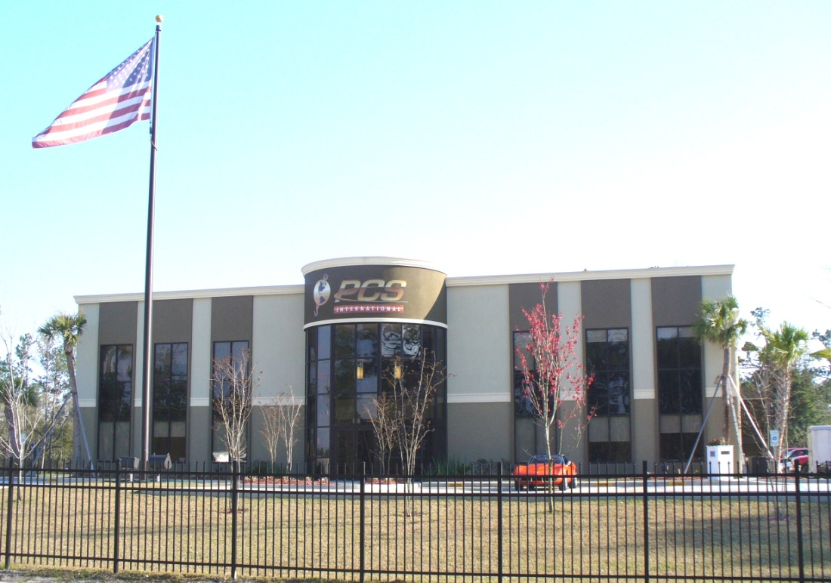
Local Commercial Projects
PCS – Platform Crane Services:
Notes:
Some of you may recognize the Platform Crane Services building, located just off I-12 at the intersection of Hwy 11. The PCS building consists of 15,000 s.f. and cost approximately $1,900,000. This state of the art facility includes a 30 x 15 board room and many other special features, including a training room, restrooms with showers and satellite conference capabilities for world wide work and oil field support. Dammon Engineering is proud to have provided our architecture and engineering services in all disciplines of this outstanding design.

Slide 4
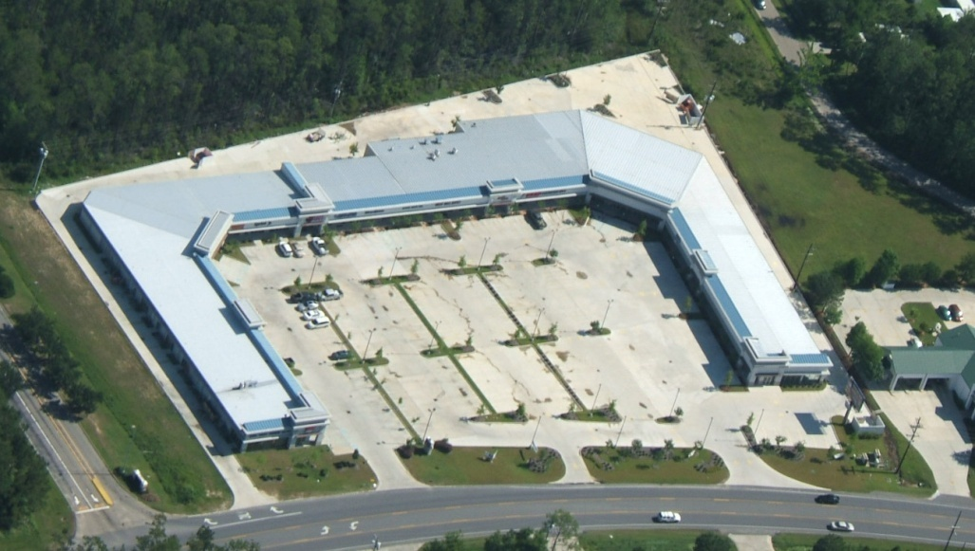
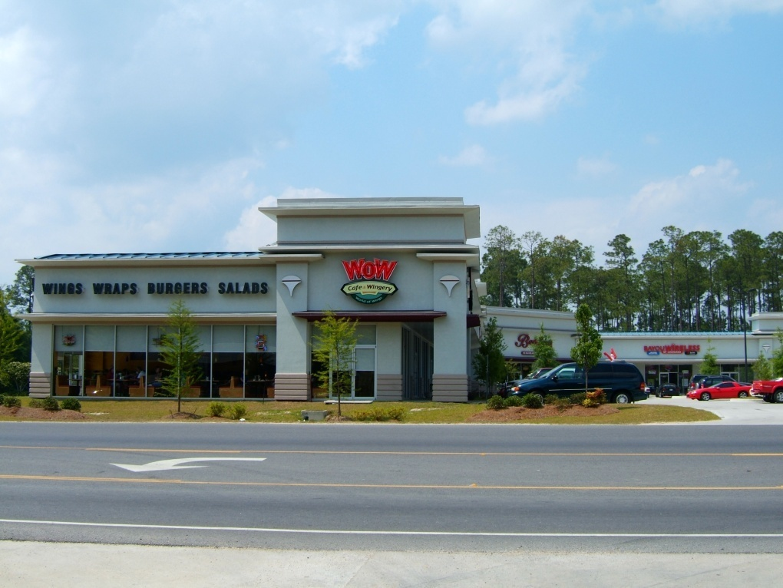
Local Commercial Projects
Mutter Shopping Center:
Notes:
This Shopping Center is located off Gause West near the Northshore Mall. This 55,236 s.f. retail project was completed in two phases. The initial phase, which you see to the left hand side in this aerial shot, consists of 19,253 s.f. The second phase, completed two years later consists of 35,983 s.f. Dammon Engineering was contacted after construction completion of the first phase, with the idea of adding Phase II. We were able to seamlessly integrate the two buildings. Dammon Engineering provided all disciplines of architectural and engineering services for this striking new facility in Slidell, which consists of several retail shops and a large 9,000 s.f. restaurant.

Slide 5
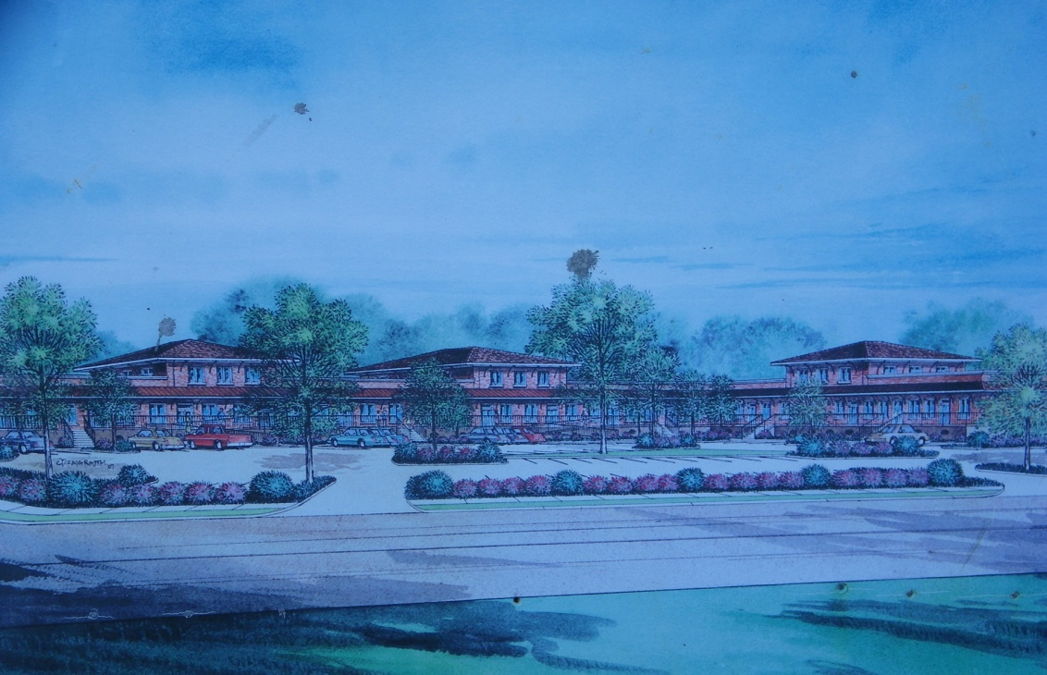
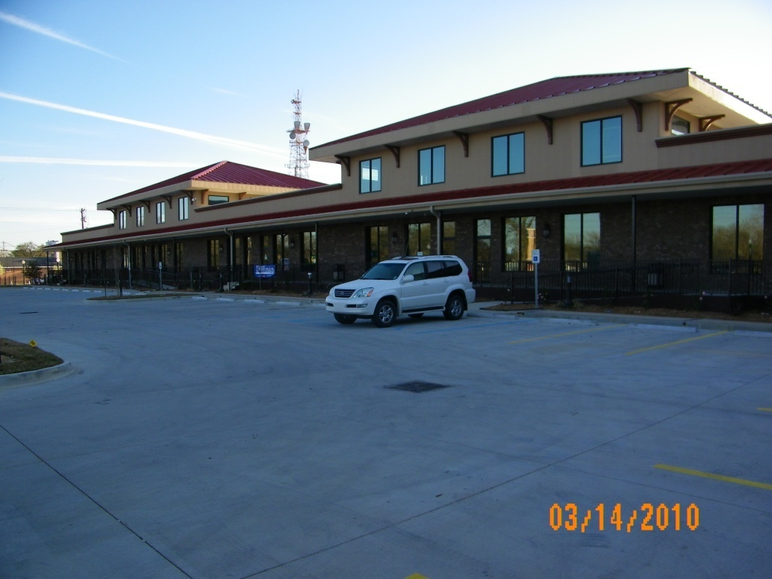
Local Commercial Projects
Old Towne Center:
Notes:
The Old Towne Center, located off Hwy. 11 at the Old “White Kitchen” location consists of 27,225 s.f. of retail and restaurant space. This facility, now nearing construction completion, has garnered great acclaim and attention with its stunning façade, bringing upscale shopping to this previously outdated central location.

Slide 6
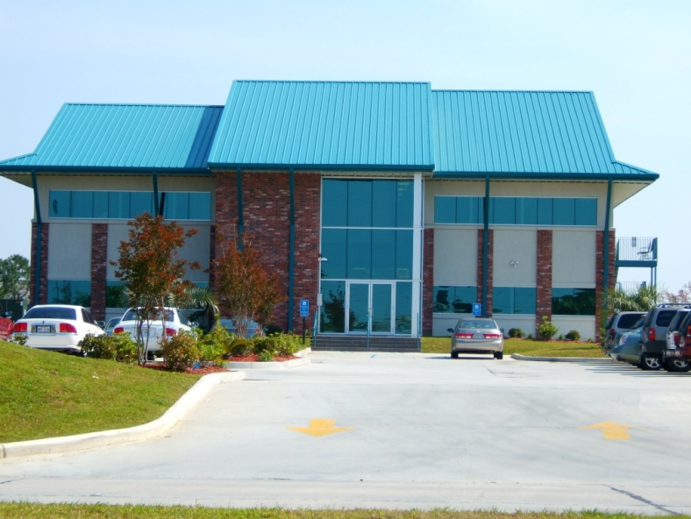
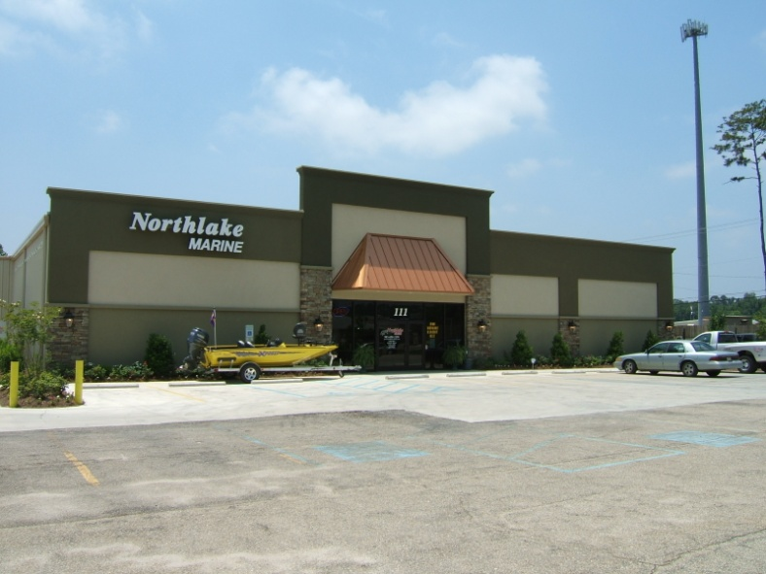
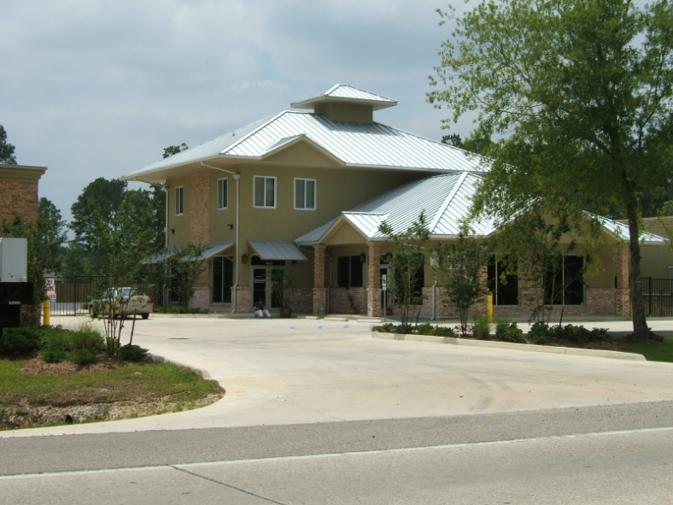
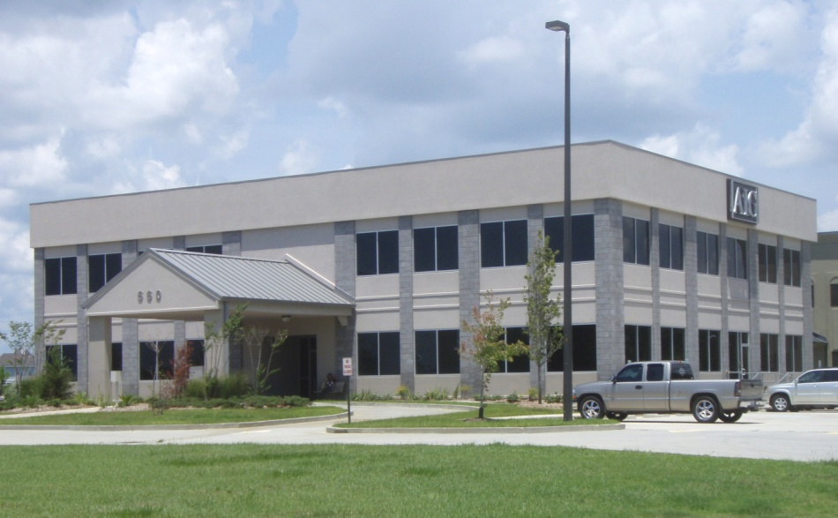
Local Commercial Projects
Other Area Projects:
Notes:
Abek Office Building, located on Oak Harbor Blvd., boasts over 20,000 s.f. of office space with an 8,000 s.f. showroom.
Northlake Marine, located on West Hall Blvd., just off of Hwy 11, consists of over 8,974 s.f. of office and showroom areas.
Planet Storage, located on Hwy. 41 in Pearl River, consists of over 100,000 s.f. of total storage space with 4,000 s.f. of office and apartment facilities.
The AIG Center, located on Oak Harbor Blvd. is a two story office building with 15,000 s.f. of area.

Slide 7
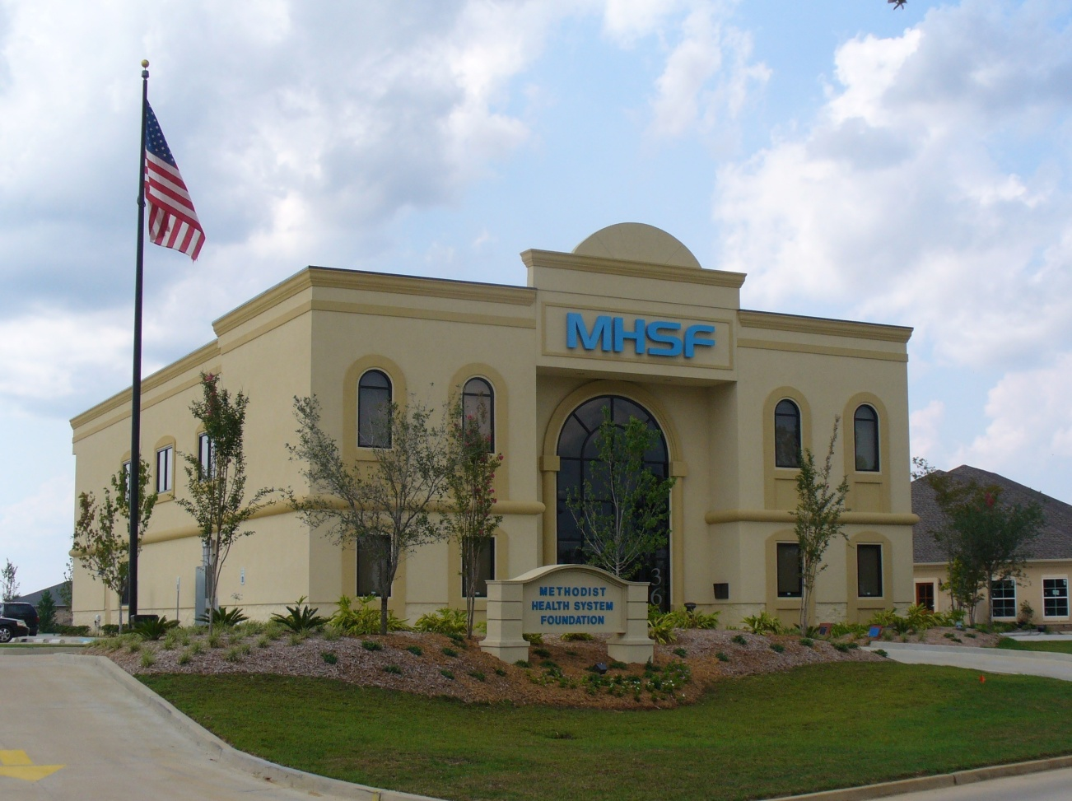
Hospital and Medical Projects
Methodist Health System Foundation:
Notes:
The Methodist Health Services facility, located on Oak Harbor Blvd. in Slidell is a 11,800 s.f. facility and includes a 40 x 20 Board Room. Dammon Engineering is proud to have provided all disciplines of architecture and engineering for the design of this state of the art facility. Construction was completed in 2007 at a cost of approximately $1,600.000.

Slide 8
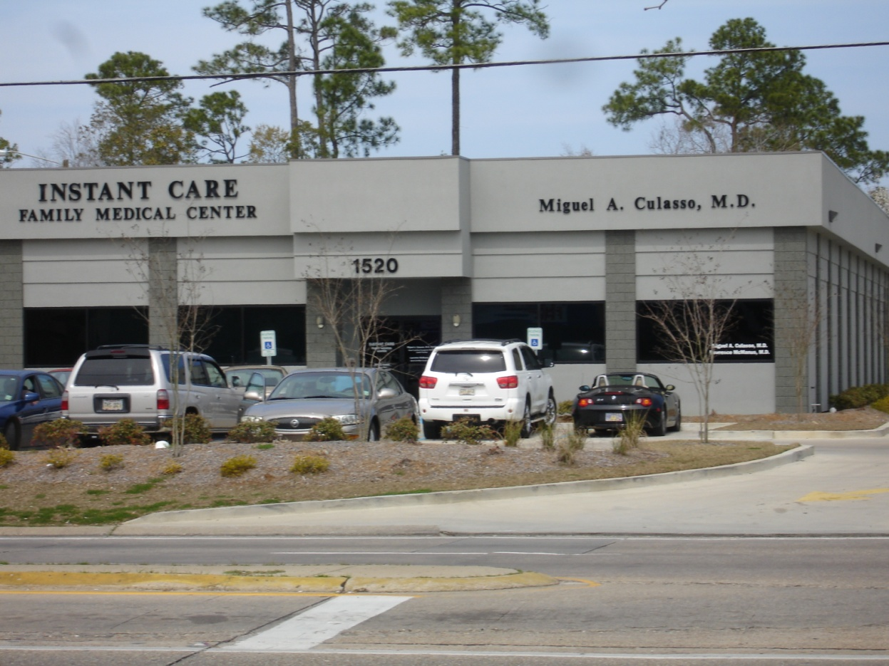
Hospital and Medical Projects
Instant Care Family Medical Center:
Notes:
The Instant Care Family Medical Center located on Gause Blvd. in Slidell is a 7,642 s.f. medical facility housing 10 exam rooms and five offices with X-Ray facilities. Construction was completed in 2009 at a cost of just under one million dollars.

Slide 9
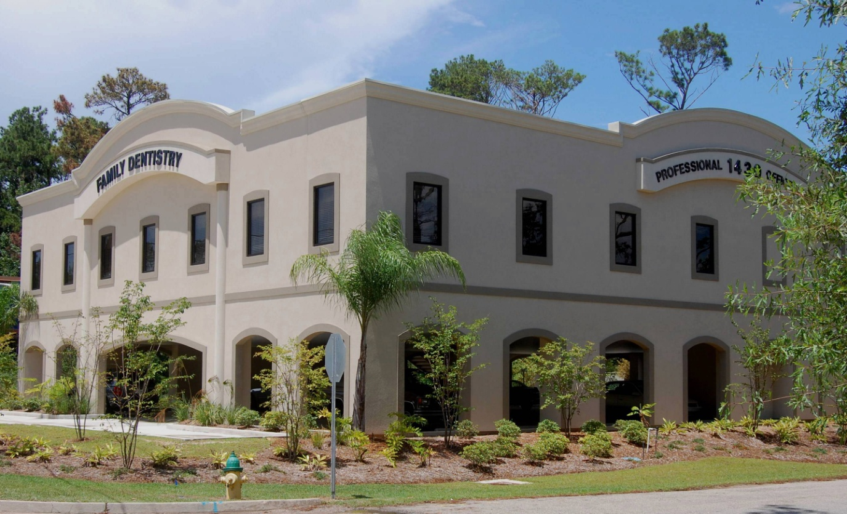
Hospital and Medical Projects
Hildebrandt Family Dentistry:
Notes:
The Hildebrandt Family Dentistry Center located on Old Spanish Trail in Slidell is a 7,164 s.f. dental facility with ground-level covered parking garage, elevators and nine treatment rooms. Construction was completed in 2009 at a cost of less $900,000.00. Dammon Engineering provided all disciplines of architecture and engineering for this outstanding dental center.

Slide 10
Hospital and Medical Projects
Slidell Memorial Hospital
Lobby/Admit Areas
Medical Intensive Care/Surgical Intensive Care Units
SMH Plaza Roof System
Founders Building Doctors’ Suite
ER Doors Relocation
O.R. Light Fixtures
Wellness Pavilion
HVAC System
Notes:
Dammon Engineering has been involved in many other medical and health care facility projects, providing both full service architect and engineering services, as well as single-discipline services as needed. The following slides contain a short list of some of those projects. Please know that Dammon Engineering has a strict policy against photographing, or publishing photographs, of the interior of existing/ operational medical facilities due to our concerns of patient privacy.
Some of our previous work for Slidell Memorial Hospital includes: Renovations for the lobby/admit areas; renovations to the medical intensive care/surgical intensive care units; redesigning roof system for the SMH Plaza; redesigning the Drs. Suite for the Founders Building; designing relocation of ER doors; calculating supports required to support the new light fixtures in the O.R.; design of the Wellness Pavilion – including 11,000 s.f., treatment rooms, offices, workout areas, rehab area with saunas; HVAC system renovations.

Slide 11
Hospital and Medical Projects
St. Tammany Parish Health Dept.
Northshore Regional Medical Center
VA Medical Center – New Orleans
VA Medical Center – Biloxi & Gulfport, MS
Notes:
Dammon Engineering designed the renovation of 14,000 s.f. for the St. Tammany Parish Health Department, adding 4,500 s.f. of space for patient care facilities.
Dammon Engineering designed a new nurses’ station and computer center for the Drug Treatment Center at Northshore Regional Medical Center.
The VA Medical Center in New Orleans engaged Dammon Engineering’s services for several projects at their facility, including renovations to labs, patient rooms, dining facilities, clinic treatment facilities and offices as well as new roof systems, repairs to the building’s structure, boiler room modifications, chillers and HVAC systems. We were also pleased to provide the design for their new 6,000 s.f. ADP facility. Dammon Engineering has worked with the VA Medical Center in New Orleans throughout the years on numerous system-specific issues, providing both full-service designs, as well as discipline-specific designs as needed.
The VA Medical Center in Biloxi contacted Dammon Engineering with their need for a new medical waste incinerator facility. Dammon Engineering provided design services for their new building, road, and utility systems for the new 600 lb./hr. incinerator as well as the demolition plan for the existing incinerator. We also provided design for the cold storage units around the VA complex for storage of red bag infectious waste.

Slide 12
Hospital and Medical Projects
East Jefferson General Hospital – Metairie, LA
Ochsner Memorial Hospital
Baptist Memorial Hospital
Southeast Louisiana Hospital
Miscellaneous Health & Hospital Related Work:
Infant Care Center, Covington, LA
Dr. Palazzo Pediatric Clinic Additions & Renovations
Zelden Physical Therapy M.O.B.
Slidell Center for Physical Therapy
Notes:
Dammon Engineering has provided numerous designs for East Jefferson General Hospital such as renovations for three floors of the hospital including patient rooms and nurses’ stations and providing Architectural, Mechanical and Electrical design to enlarge operating rooms and the entire O.R. area and renovations to include a doctors’ lounge and library. We have also worked with East Jefferson General Hospital on many system-specific issues such as the HVAC systems, sterilizer exhaust systems, oxygen air & vacuum systems and emergency power systems as well as specific facilities and services such as the X-ray lab, bacteria lab, mammography lab and office, angiogram lab and office and trauma treatment facility.
Dammon Engineering redesigned the Human Resource offices for Ochsner Memorial Hospital as well as the visitation and activities area on the hospital’s fifth floor. We also designed the new LTAC for Gulf States, which is also located on the fifth floor, as well as the new pre-operative holding area.
At Baptist Memorial Hospital, Dammon Engineering provided design for the new eighth floor hyperbaric suite and we designed the new boiler system for Southeast Louisiana Hospital.
Other noteworthy projects include: The Infant Care Center in Covington, Additions & Renovations to Dr. Palazzo’s Pediatric Clinic, Zelden physical Therapy and the Slidell Center for Physical Therapy.
These are just a few of the many Hospital and Medical Projects Dammon Engineering has been proud to have worked on.

Slide 13
Interior or exterior video

Slide 14
DAMMON ENGINEERING, INC. Architects & Engineers
Proudly Serving the Gulf South Region Since 1978
Notes:
Throughout the years Slidell Memorial has been the “go to” facility for medical and emergency care in Slidell. We at Dammon Engineering are confident that we can design and coordinate construction on a facility that will reflect the high standards of Slidell Memorial while maintaining the budget set forth. We have been proud to serve this area for over thirty years and with three generations and we would be proud to serve Slidell Memorial now and into the future.

