Slide 1
SSC TARMAC CEMENT INSTALLATION
Area #1. The area depicted on the map as area # 1 is required to receive the SSC next year. This area is approximately 51,629 square feet.
Area #2. The depicted on the map as area #2 is required to receive future SSC vessels. This area measures approximately 52,578 square feet.

Slide 2
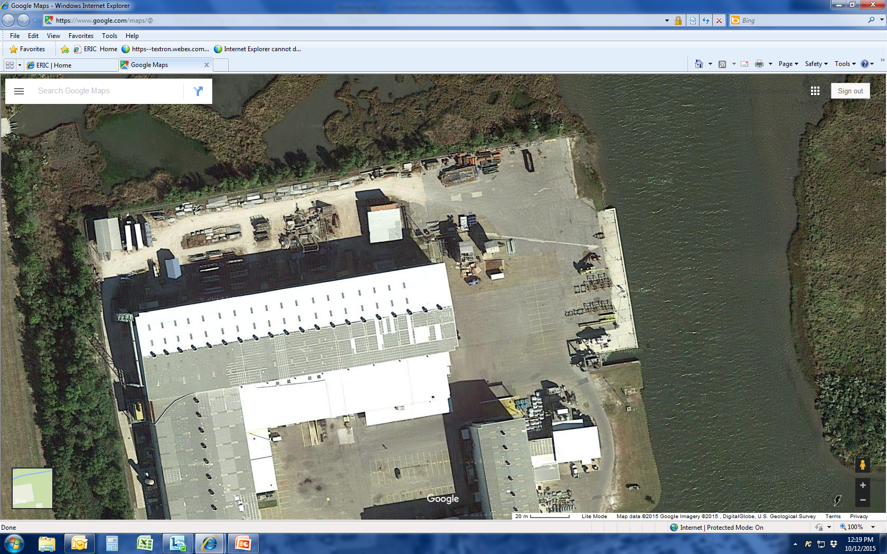
240’”
108’
36’
30’
Existing landing Pads (4X) to remain and to be leveled
95’
30’
30’
Area #1
145‘
122’
270’
70’
55’
270’
62’
7’
Area #2
35’
28’
30’
10’
84’
100’
250’

