Slide 1

LAFA Food Distribution
July 26, 2013

Slide 2
Introduction:
► The problem is that the Emergency Power System at the Food Distribution Center is not configured to operate automatically, however an Automatic Transfer Switch is installed.
► The existing Emergency Power System is powered by a 360 KW Generator.
► The generator is not powerful enough to start all of the motors at the same time, but will carry the load if the motors are started one at a time.
► The system is currently operated manually by first starting the generator, then each load is brought on line one at a time.
► Three different design options will be presented, along with costs involved, that will allow the Emergency Power System to operate automatically.

Slide 3
Existing Configuration
Equipment Room
Generator
360KW
Main Circuit Breaker
MDP
SWITCHBOARD
A.T.S.
2500AF
2500AT
N E
LOAD
600A
Switch
2500AF
2500AT
Utility Power
SERVICE ENTRANCE
Existing Equipment

Slide 4
Existing Configuration
MDP
Main Distribution Panel
Dist.
Panel
Dist.
Panel
Dist.
Panel
Dist.
Panel
Dist.
Panel
Dist.
Panel
Dist.
Panel
Dist.
Panel
Non Essential Loads
Coolers
Power Distribution
Existing Equipment

Slide 5
Option 1 – Provide Automated Control System
This Option will provide an automated control system for the refrigeration equipment to:
► Sequentially start the coolers so as not to exceed the system capacity.
► Shed all non essential loads
► The system shall have the capability to shed loads as required if the generator should become overburdened.

Slide 6
Proposed Configuration – Option 1
Equipment Room
Generator
360KW
Main Circuit Breaker
MDP
SWITCHBOARD
A.T.S.
2500AF
2500AT
2500AF
2500AT
N E
LOAD
600A
Switch
Utility Power
SERVICE ENTRANCE
New Equipment
Existing Equipment

Slide 7
Proposed Configuration – Option 1
MDP
Main Distribution Panel
Install New Contactors
Dist.
Panel
Dist.
Panel
Dist.
Panel
Dist.
Panel
Dist.
Panel
Dist.
Panel
Dist.
Panel
Dist.
Panel
Non Essential Loads
Coolers
POWER DISTRIBUTION
New Equipment
Existing Equipment

Slide 8
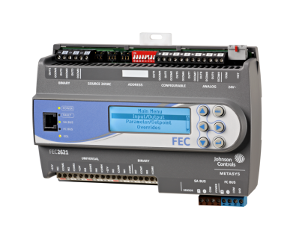
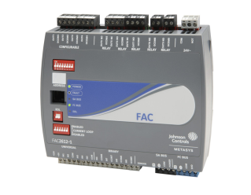
Proposed Configuration – Option 1
SEQUENCE OF OPERATION:
When loss of power is detected, all refrigeration units are disabled, and non essential loads are shed.
The generator starts, and the automatic transfer switch initiates a transfer.
A timing sequence begins that starts each piece of equipment sequentially.
If the generator becomes overloaded, loads will be shed until the generator returns to normal.
When normal power is restored, the system resets, and all equipment will run normally.
FAC Controller
IOM Input/Output Modules
To North Coolers
To South Coolers
JOHNSON CONTROL SYSTEM
New Equipment
Existing Equipment

Slide 9
Option 2 – Swap out Generator and Provide Contactors to Shed Non Essential Loads
This Option will provide the following:
► Swap out the 360 KW Generator with a 480 KW Generator. The 480 KW Generator is existing and services another building on the same facility. The 360 KW generator will replace the 480 KW generator.
► Install contactors to shed non essential loads while the generator is running. They will drop out in the event of a normal power failure and automatically return when power is restored.

Slide 10
Proposed Configuration - OPTION 2
Equipment Room
Relocated
Generator
480KW
Main Circuit Breaker
MDP
Switchboard
A.T.S.
2500AF
2500AT
2500AF
2500AT
N E
LOAD
1000A
Switch
Utility Power
SERVICE ENTRANCE
New Equipment
Existing Equipment

Slide 11
Proposed Configuration – OPTION 2
MDP
Main Distribution Panel
Install New Contactors
Dist.
Panel
Dist.
Panel
Dist.
Panel
Dist.
Panel
Dist.
Panel
Dist.
Panel
Dist.
Panel
Dist.
Panel
Non Essential Loads
Coolers
POWER DISTRIBUTION
New Equipment
Existing Equipment

Slide 12
Option 3 – Swap out Generator and Reconfigure Power System
This Option will replace the Generator and separate the Normal Power System from the Emergency Power System.
► Swap out the 360 KW Generator with a 480 KW Generator. The 480 KW Generator is existing and services another building on the same facility. The 360 KW generator will replace the 480 KW generator.
► Reconfigure wiring at the service entrance as shown in the following diagram to connect the Main Distribution Panel in parallel with the Automatic transfer Switch..
► Install new Emergency Power Panel and relocate power feeders from HVAC equipment to it.
► The Existing Main Distribution Panel will not be energized by the generator.

Slide 13
Proposed Configuration - OPTION 3
Equipment Room
Relocated
Generator
480KW
MDP
Switchboard
A.T.S.
MAIN 1
MAIN 2
2500AF
800AT
2500AF
2500AT
N E
LOAD
1000A
Switch
Utility Power
TO EMERGENCY PANEL
SERVICE ENTRANCE
New Equipment
Existing Equipment

Slide 14
Proposed Configuration – OPTION 3
MDP
Main Distribution Panel - Normal Power
EDP
Emergency Distribution Panel
J
J
J
J
Reroute Existing Loads to New Panel
Dist.
Panel
Dist.
Panel
Dist.
Panel
Dist.
Panel
Dist.
Panel
Dist.
Panel
Dist.
Panel
Dist.
Panel
Non Essential Loads
Coolers
POWER DISTRIBUTION
New Equipment
Existing Equipment

