Slide 1
AMBIENT AIR QUALITY MONITORING FOR PM10 AND Pm2.5
ENCE 3323: Introduction to Environmental Engineering

Slide 2
PM10 and PM2.5 in Ambient Air
What are the health impacts of particulate matter (PM) in ambient air?
What are the sources of PM emission
What are the ambient standards for PM10 and PM2.5?
What are some specific studies that relate PM10 and PM2.5 exposures vs. health effects

Slide 3
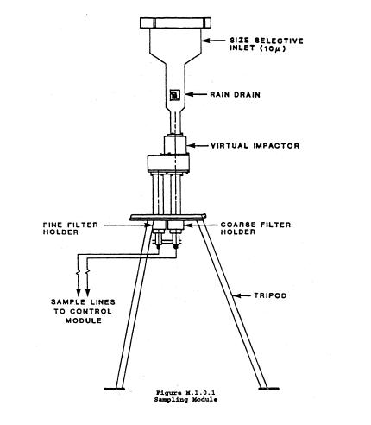
Andersen Dichotomous Sampler

Slide 4
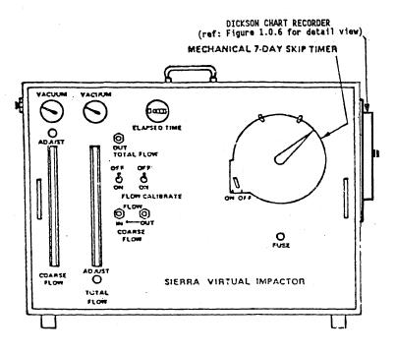
Flow Controller Module of the Andersen Dichotomous Sampler

Slide 5
Virtual Impactor – Point of Separation of Fine and Coarse Particles

Slide 6
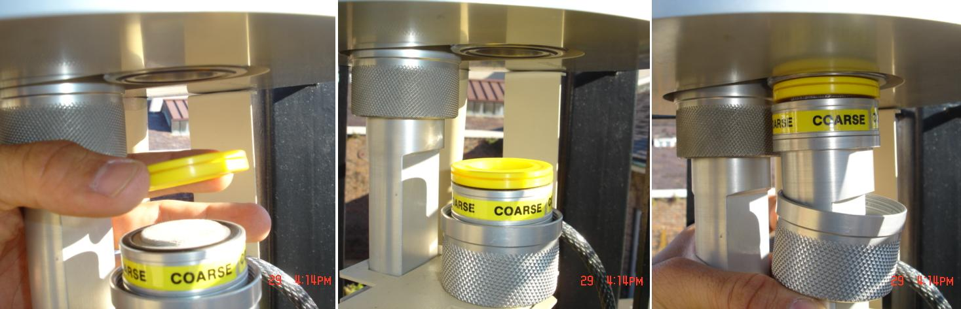
Installing the Coarse Filter in the Dichotomous Sampler

Slide 7
Data Obtained from a Study Recently
No. | Description of the Parameter Measured | Unit | Run1 | Run2 | Run3
1 | Initial weight of the conditioned coarse filter | mg | 122.1 | 122.2 | 122.1
2 | Final weight of the conditioned coarse filter | mg | 122.5 | 122.8 | 122.6
3 | Initial weight of the conditioned fine filter | mg | 119.1 | 119.1 | 119.1
4 | Final weight of the conditioned fine filter | mg | 120.1 | 121.3 | 120.8
5 | Initial rotameter flow reading for coarse filter (adjusted to site conditions) | lpm | 1.6 | 1.6 | 1.6
6 | Final rotameter flow reading for coarse filter (adjusted to site conditions | lpm | 1.5 | 1.5 | 1.54
7 | Initial rotameter flow reading for fine filter (adjusted to site conditions) | lpm | 15 | 15 | 15
8 | Final rotameter flow reading for fine filter (adjusted to site conditions) | lpm | 14.9 | 14.8 | 14.9
9 | Site temperature | Deg. C | 25 | 26 | 28
10 | Site pressure | mmHg | 755 | 758 | 763
11 | Total sampling time | min | 1430 | 1440 | 1456
 | Note: Standard Ambient Temperature: 0 Deg. C.; Std. Pressure: 760 mm Hg

Slide 8
Calculations Needed for Your Lab Report
No. | Parameter to be Calculated | Unit | Run 1 | Run 2 | Run 3 | Average of 3 Runs
1 | Mass increase on coarse filter (Particles >PM2.5 and <PM 10) | µg
2 | Mass increase on fine filter (Particles <PM2.5) | µg
3 | Average flow rate on coarse filter | lpm
4 | Average flow rate on fine filter | lpm
5 | Average air volume sampled for coarse particles (site conditions) | m³
6 | Average air volume sampled for fine particles (site conditions) | m³
7 | Ambient PM2.5 Concentration at site conditions | µg/m³
8 | Ambeint PM10 Concentration at site conditions | µg/m³
9 | Average air volume sampled for coarse particles (standard conditions) | m³
10 | Average air volume sampled for fine particles (standard conditions) | m³
11 | Ambeint PM2.5 Concentration at standard conditions | µg/m³
12 | Ambient PM10 Concentration at standard conditions | µg/m³
Did the area sampled comply with the National Ambient Air Quality Standards for PM₁₀ and PM_{2.5}? Comment on the attainment status of the region

Slide 9
BOD Experiment
What is BOD and BOD5?
What does the value of BOD indicate?
Importance of BOD and BOD5 experiments in water and wastewater engineering?
What is the procedure?

Slide 10
Oxygen Demanding Material
Biochemical Oxygen Demand (BOD)
Chemical Oxygen Demand (COD)

Slide 11
DEFINITION OF BOD
Amount of oxygen consumed by microorganisms as they consume biodegradable organic matter.

Slide 12
Laboratory measurement of BOD
Prepare Dilution of Wastewater Sample
Prepare a Blank
Incubate Sample and Blank 5 d @ 20 º C
Measure DO Remaining and Calculate
BOD

Slide 13
BOD CALCULATION
BOD_{t} = (DO_{b,t} - DO_{s,t}) (D.F.)

Slide 14
Dilution
Sample Size (%)
= (V of undiluted sample / V of diluted sample) *100

Slide 15
Dilution Factor
Dilution Factor
= 100 / (Sample Size in %)

