Slide 1
Clark UH Method
A Time – Area method

Slide 2
Time-Area UH theory
Establishes a relationship between the travel time and a portion of the basin that may contribute runoff during the travel time.
Area closest contributes the soonest
Watershed is broken into areas of equal travel time called isochrones
Mean travel time is calculated and resulting time area curve is produced.
Time-area curve shows the % of basin area that has contributed by a given time t.

Slide 3
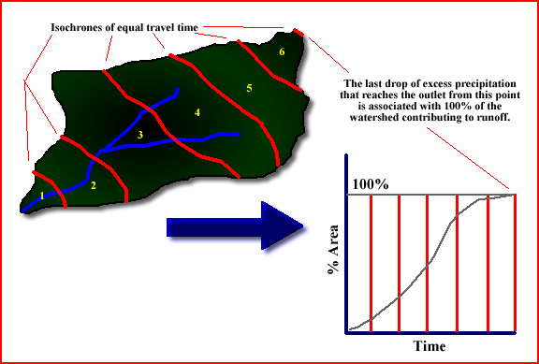

Slide 4
Difficult to determine the zones of equal travel time
Cummulative time-area curve is formed by summing the incremental areas and the corresponding travel times.
time of concentration is the time it takes a parcel of water to reach the outlet from the furthest point in the drainage basin.
Excess precipitation is thought of as being deposited “instantaneously” over the each isochrone area.
The volume of each areas excess precipitation is equal to a volume that is 1 in deep over the area.

Slide 5
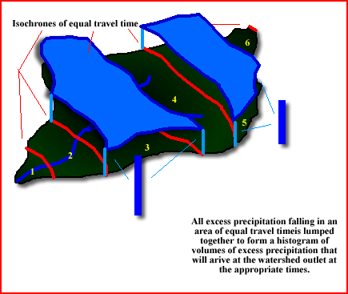

Slide 6
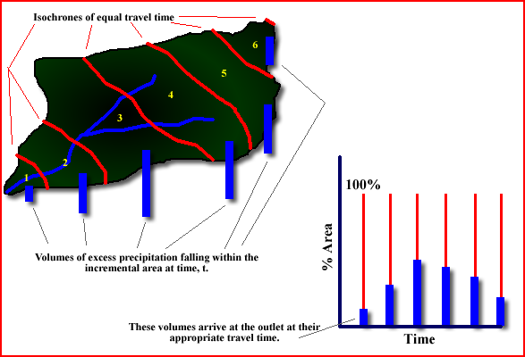

Slide 7
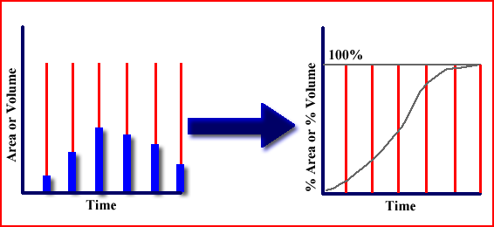

Slide 8
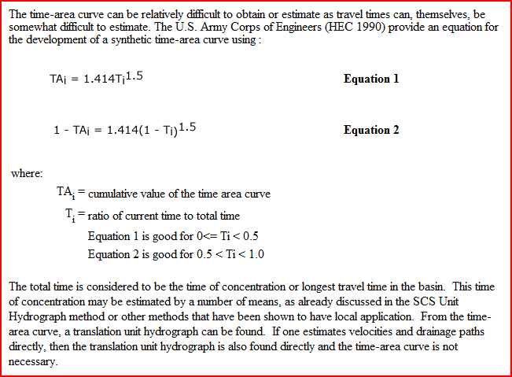

Slide 9
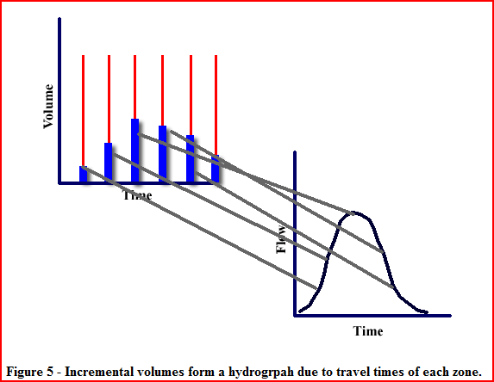

Slide 10
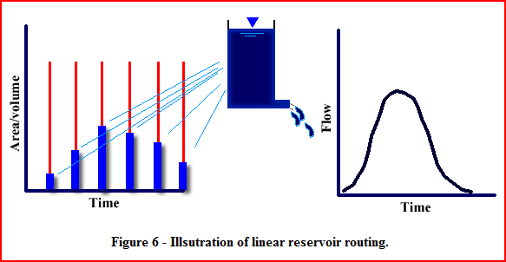

Slide 11
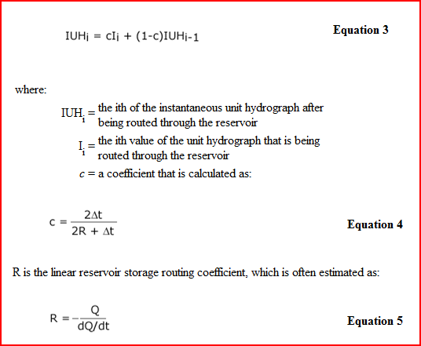

Slide 12
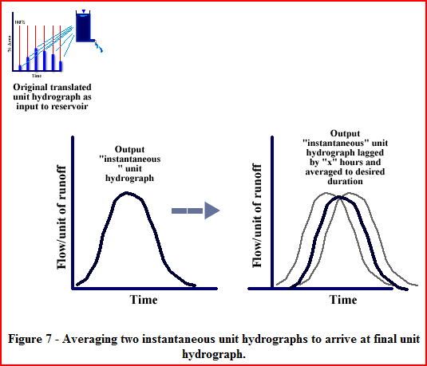

Slide 13
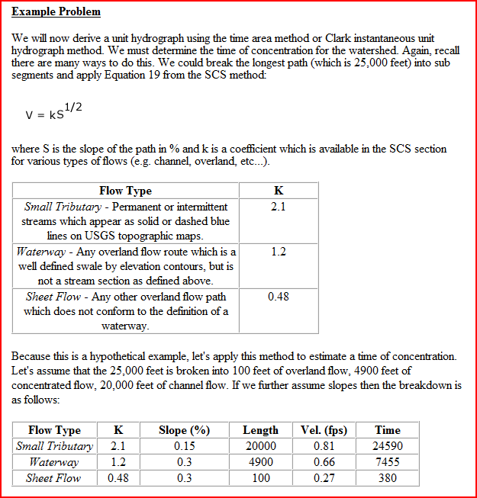

Slide 14
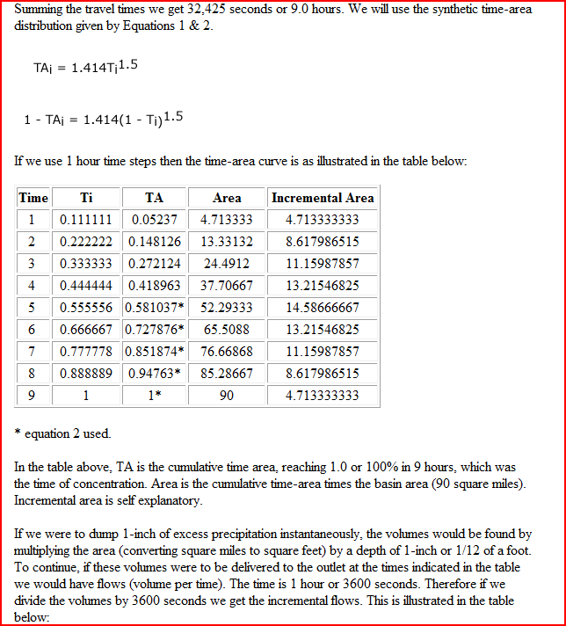

Slide 15
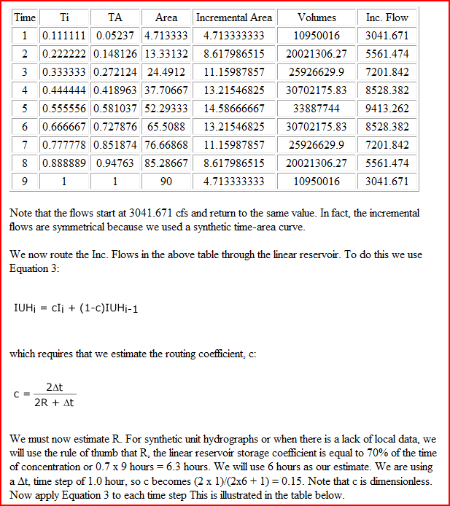

Slide 16
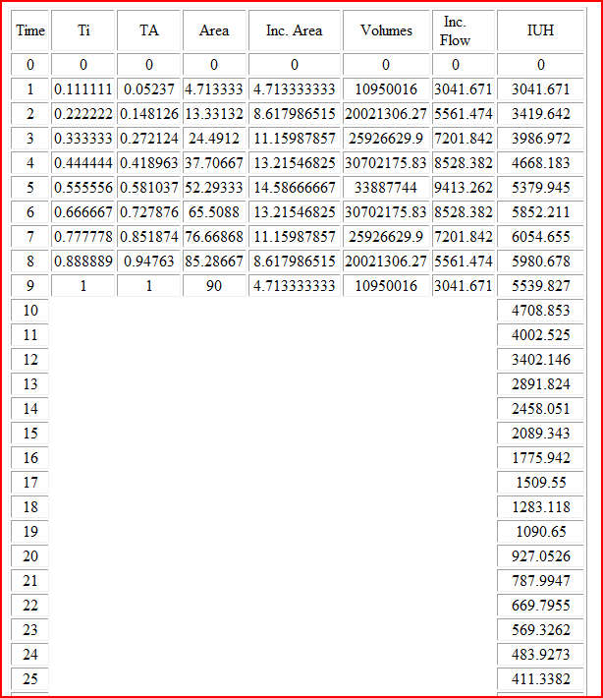

Slide 17
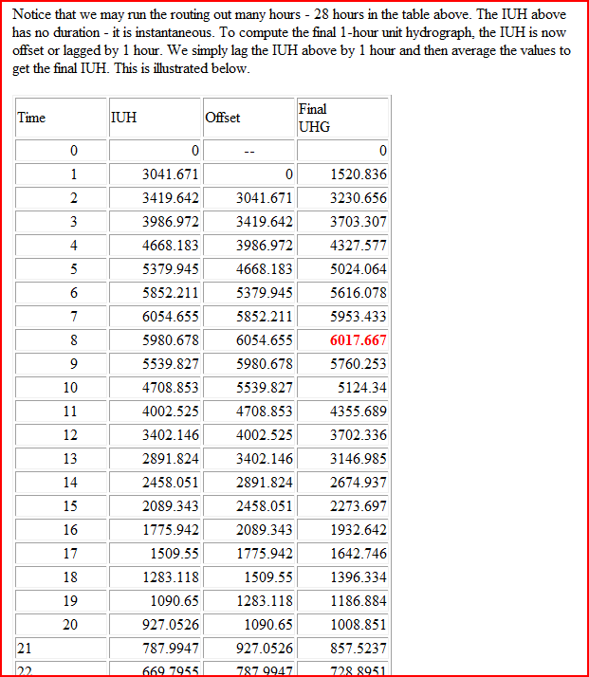

Slide 18
