Slide 1
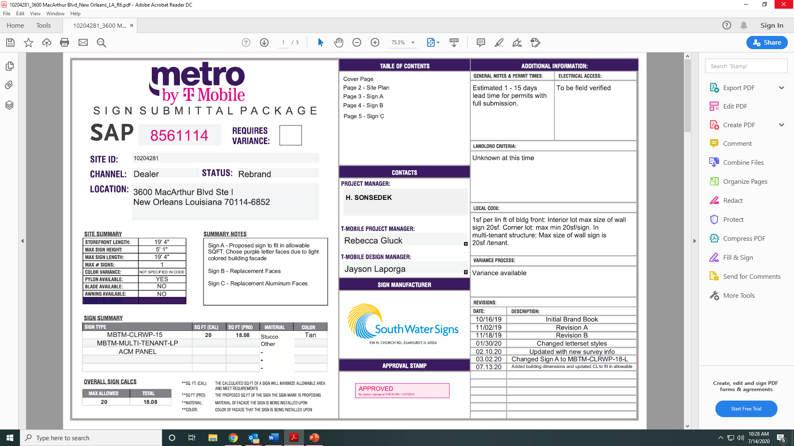

Slide 2
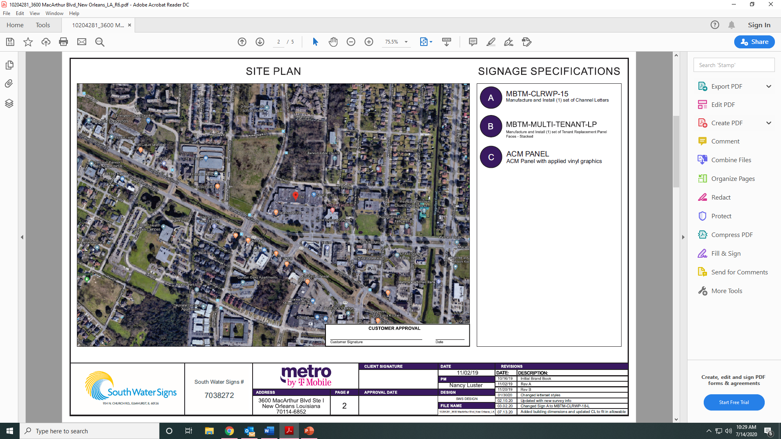

Slide 3
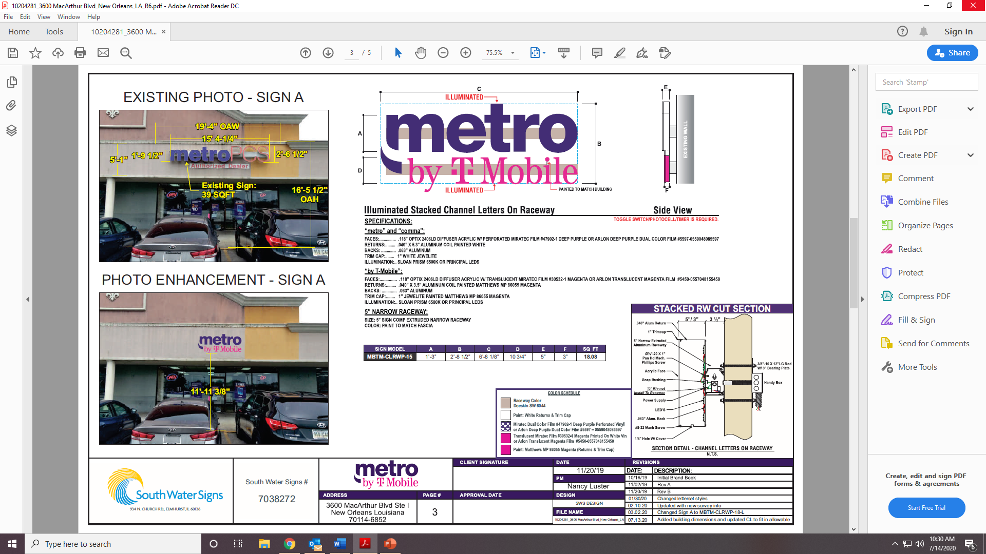

Electrical notes:
1.All electrical components to be UL approved
2.Customer is responsible for one (1) 120v/ 20a dedicated circuit with ground per sign within 6’of sign.
3.Lockout switch installed at panel box for all electrical signs.
4.Install in accordance with N.E.C. Article 600 and/ or local codes. This includes proper grounding and bonding of signs.

Slide 4
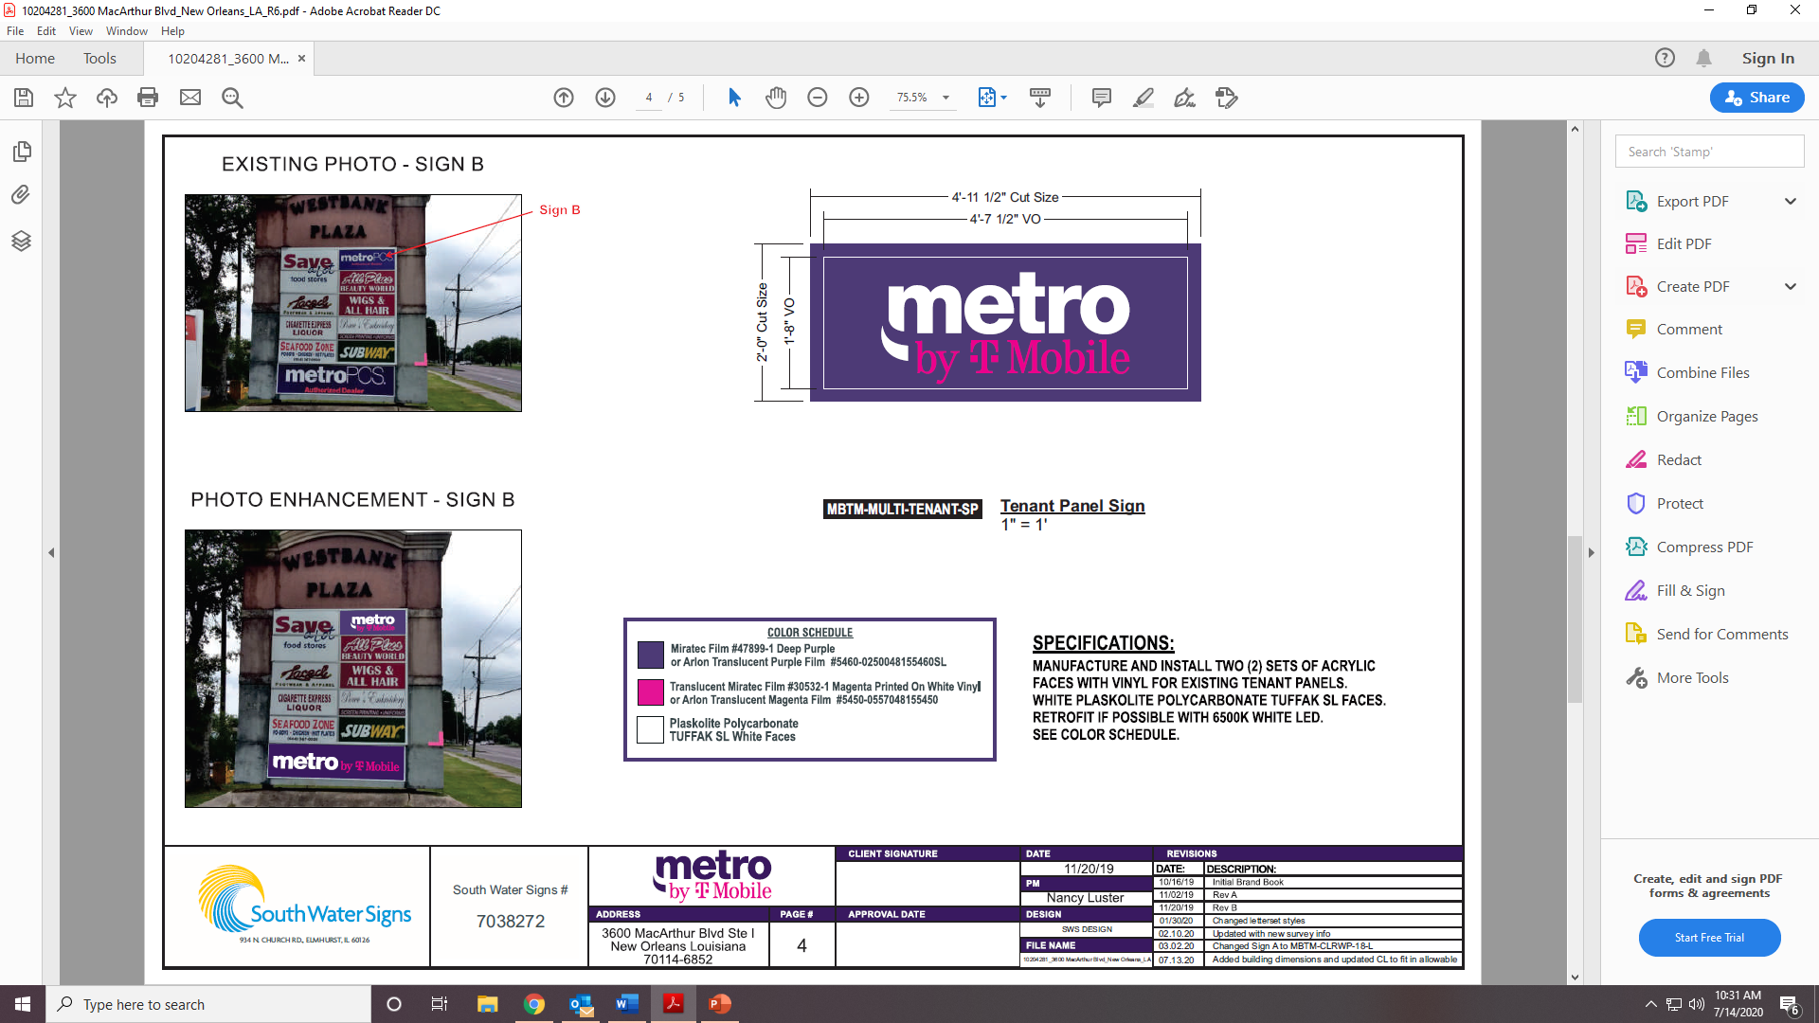
FACE REPLACEMENT ONLY

Slide 5
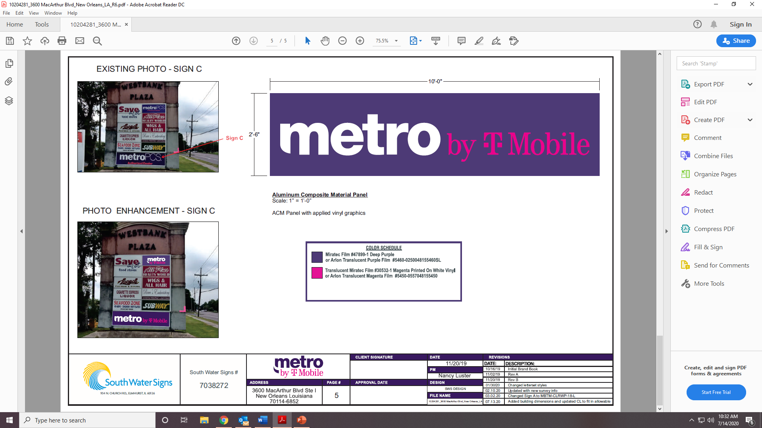
FACE REPLACEMENT ONLY

